Slide 1
Data visualization
——BSU
hanqing guo

Slide 2
Data source
Mongo DB export complex JSON file
Due to it is not clean JSON, so load the JSON file and parse to different data structure.
Export_champion.js export_champion.js
Champion.json champions.json
Export_kill_Damage_Money.js export Kill_Damage_Money.js
Damage.json money.json kills.json damage.json kills.json money.json

Slide 3
Bar Chart
Bad Bar chart
bar_chart_bad.html
Good Bar chart
bar_chart11111.html
Each game have 10 participants, 5 in blue team and 5 in purple. Each participant play a specific role in one game, mid, ADC, top, jungle, and support.
The figure above shows the total Kill made by all games with different roles.
When click the choose box, it can load blue team kills distribution only.

Slide 4
Pie Chart
Bad Pie Chart
bad_piechart.html
Good Pie Chart
sun_brust.html
When click the inner part, it will zoom in, the new pie chart will be regenerated as the inner part to be center of circle. Here click the team200, which means the purple team.
The middle part shows what the data is. It has 3 kind of data to load, damage, money and kills.

Slide 5
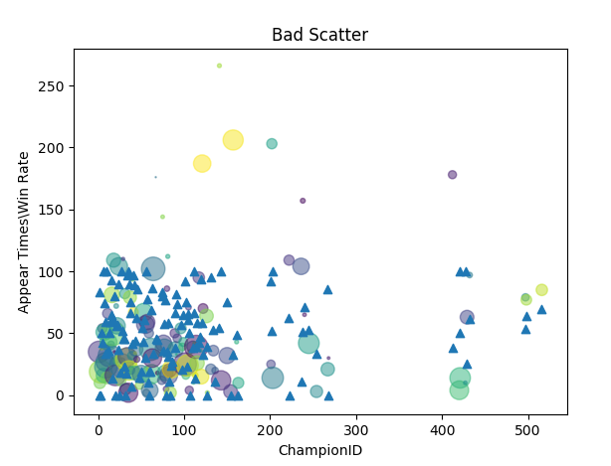
Scatter chart
Bad Scatter Chart
This chart has same data source. But the scatter is random size which disturb our analysis, besides, champion ID is not an sortable attribute, we cannot see straightly for the better appear times and win rate attributes.

Slide 6
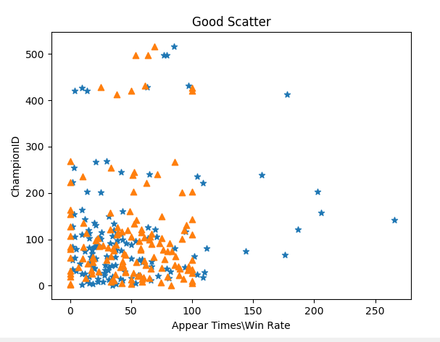
Scatter chart
Good Scatter Chart
This scatter chart shows the relationship between Champion Appear Times and win rate, the star means Appear time and the triangle shows the win rate for specific champion. This is good because it shows which champion win more and the figure has rank attribute. With increase the X axis, it shows the hottest champion ID in Y label and better win rate Champion. It also gives some hint to avoid choose some champion hot but low win rate.

Slide 7
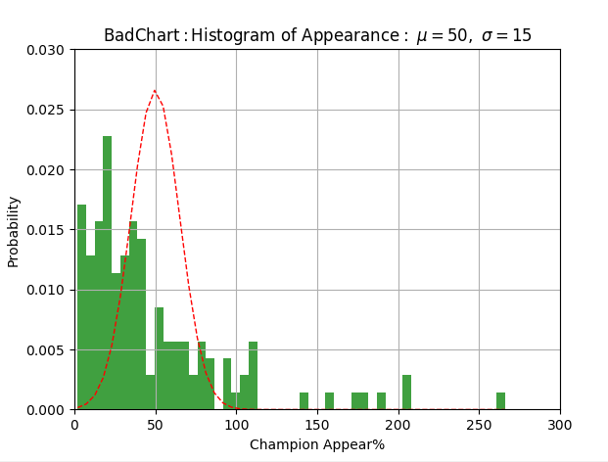
Histogram Chart
Bad Histogram Chart
This figure is bad histogram, because champion appear times is not good attributes, this histogram just show most champion appear 0-50 times, besides that, nothing useful information it shows.

Slide 8
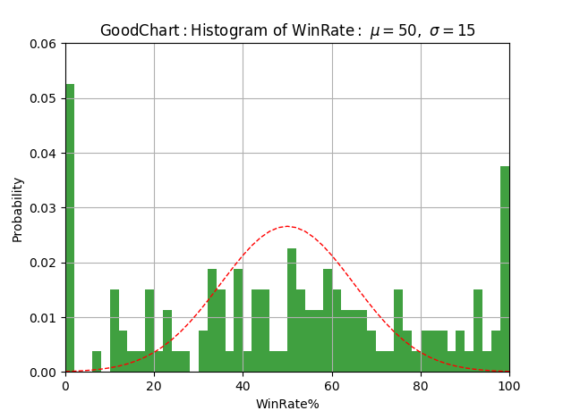
Histogram Chart
Good Histogram Chart
The good histogram shows the Win rate distributions, as the figure shows compares to the Gaussian distribution line, more champions win rate is close to 50%, while some champion has small appearance times has 0 or 100% win rate, due to our data size.
That means some champion with less player want to play is different performance.

Slide 9
Network chart
Bad Network chart
network.html
Good Network chart
good_network.html
The good network is animated network, it shows the relationship between each player role and position, the most carry role has biggest size and being the hero in team(central) and relationship in the team is bonded by group contribution, the more damage it make, the thicker line between leader and supporter. It also shows the position in the map and generate a table.

